Slide 1
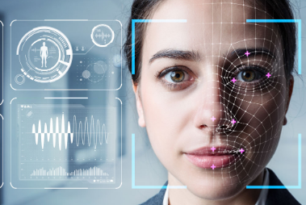
Face Recognition System for Gender, Glasses & Shirt Color Detection
A Machine Learning-Based Image Classification Solution
Presented by: Rao Muhammad Farhan Suhail
Date: 28th-May-2025
Project Given by: Programmers Force

Slide 2
Project Objective
• Identify the gender of a face (captured or uploaded)
• Detect if the person is wearing glasses
• Determine the color of the person's shirt
COLAB CODE LINK: https://colab.research.google.com/drive/1Ayk0IbRpUWhmT3HEmSk8iZaUOsKOJQeQ?authuser=1#scrollTo=Dh_JlecraRF0

Slide 3
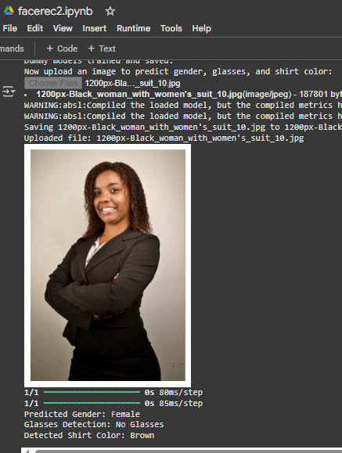

Slide 4
Dataset Information
Total Images Scraped/Used: ~13,000 images
•Dataset Source:
Kaggle 'LFWPeople' Dataset:
https://www.kaggle.com/datasets/atulanandjha/lfwpeople

Slide 5
Model Architecture Overview
• CNN Layers:
- Input Layer (128x128x3)
- Conv2D + ReLU
- MaxPooling
- - Flatten
- Dense (64 units, ReLU)
- Dense (1 unit, Sigmoid)
• Used for: Gender and Glasses detection

Slide 6
Shirt Color Detection
Approach: RGB averaging from lower half of image
Color Mapping via distance to predefined RGB values
No training model used — rule-based method

Slide 7
Why This Model?
Simple CNN is effective for binary image classification
Lightweight and fast — suitable for Colab execution
Easily extendable to other tasks like expression or age detection

Slide 8
Alternative Models
MobileNetV2 (Pre-trained, lightweight)
Faster training with transfer learning
Higher accuracy for complex datasets
Not used to keep training fast and customizable

Slide 9
Inference & Execution Time
Average Detection Time:
- Gender: ~0.3 seconds
- Glasses: ~0.3 seconds
- Shirt Color: ~0.1 seconds
Total: ~0.7 seconds/image

Slide 10
Limitations
Dummy training — limited accuracy
No real labels for shirt color
Misclassification if glare or poor image
Dataset diversity might be low

Slide 11
Files in Submission Folder
gender_model.h5 and glasses_model.h5
face_detection_notebook.ipynb
MS WORD file including the code with instructions
Sample test images
presentation.pptx and 5-minute recording

Slide 12
How to Run the Solution
1. Open Colab and run face_detection_notebook.ipynb
2. Upload kaggle.json to fetch dataset [depends if code is stuck or gives an error]
3. Upload image (JPG/PNG)
4. Outputs:
- Gender
- Glasses status
- Shirt color

Slide 13
Thank You
Questions?
Contact: [rao2farhan@gmail.com - 00923351452544]

